Slide 1

Unlocking Customer Insights
Analyzing 3,900 transactional records to optimize marketing and product strategies.

Slide 2

Project Objective
Leverage Consumer Data
Enhance Product Strategy
Identify trends to improve customer engagement and optimize marketing strategies.
Use insights from shopping data to refine product offerings and development.

Slide 3
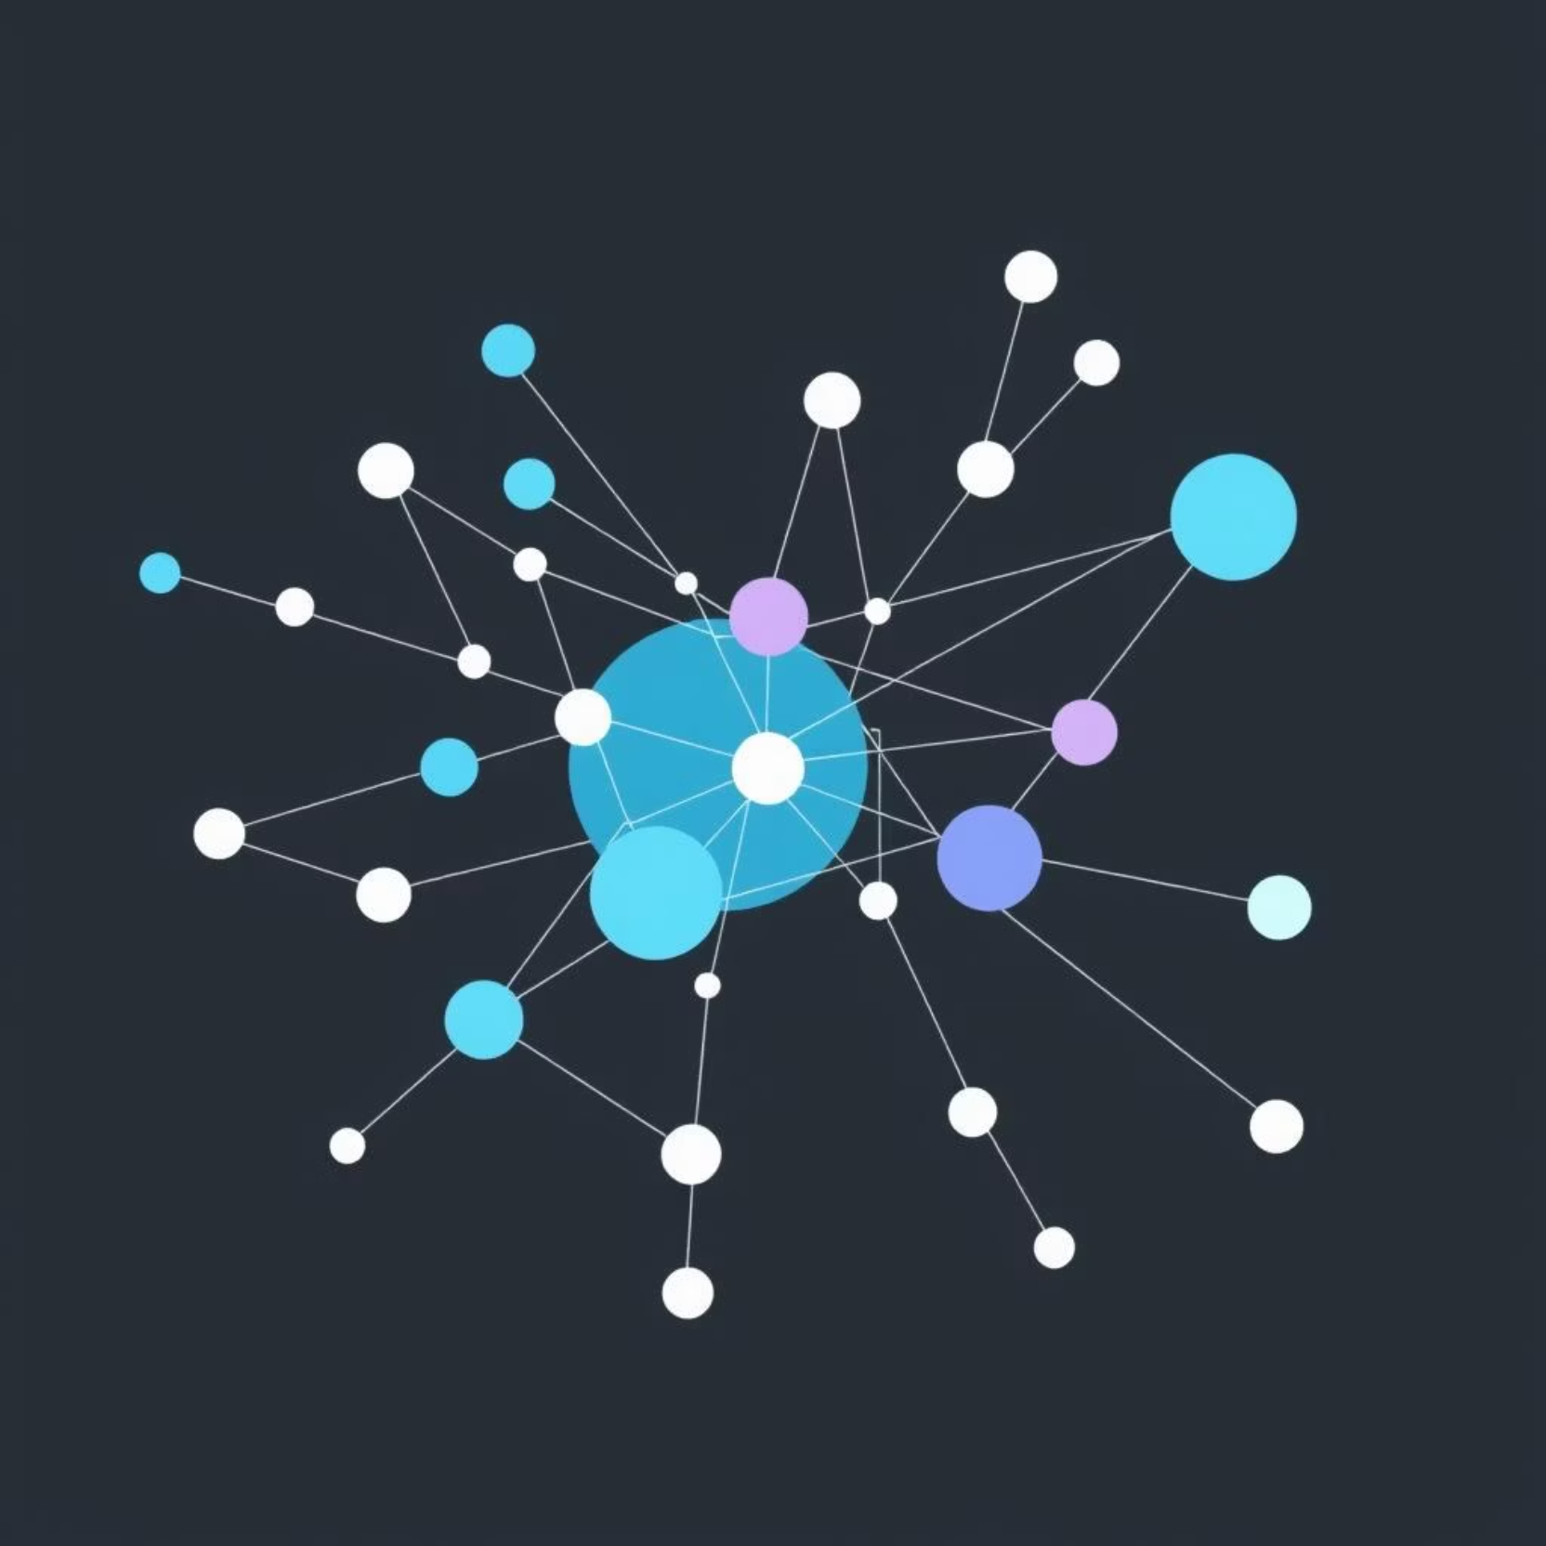
Dataset Overview
Key Data Fields
Customer Demographics (age, gender, location)
Purchase Details (item, category, amount, season)
Shopping Behavior (discount, frequency, previous purchases)
Customer Feedback (review rating)

Slide 4
Data Preparation Process
01
Dataset Overview
Load & Explore
Dataset loaded, structure and descriptive statistics explored.
Rows: 3,900
Columns: 18
02
Key Data Fields: Demographics, Purchase Details, Behavior
Imputation
Missing review ratings imputed using median per category.
Data Quality: 37 missing values in review_rating
03
Feature Engineering
New features: age_group and purchase_frequency_days created.
04
Clean & Export
Redundant data dropped, cleaned dataset exported.

Slide 5
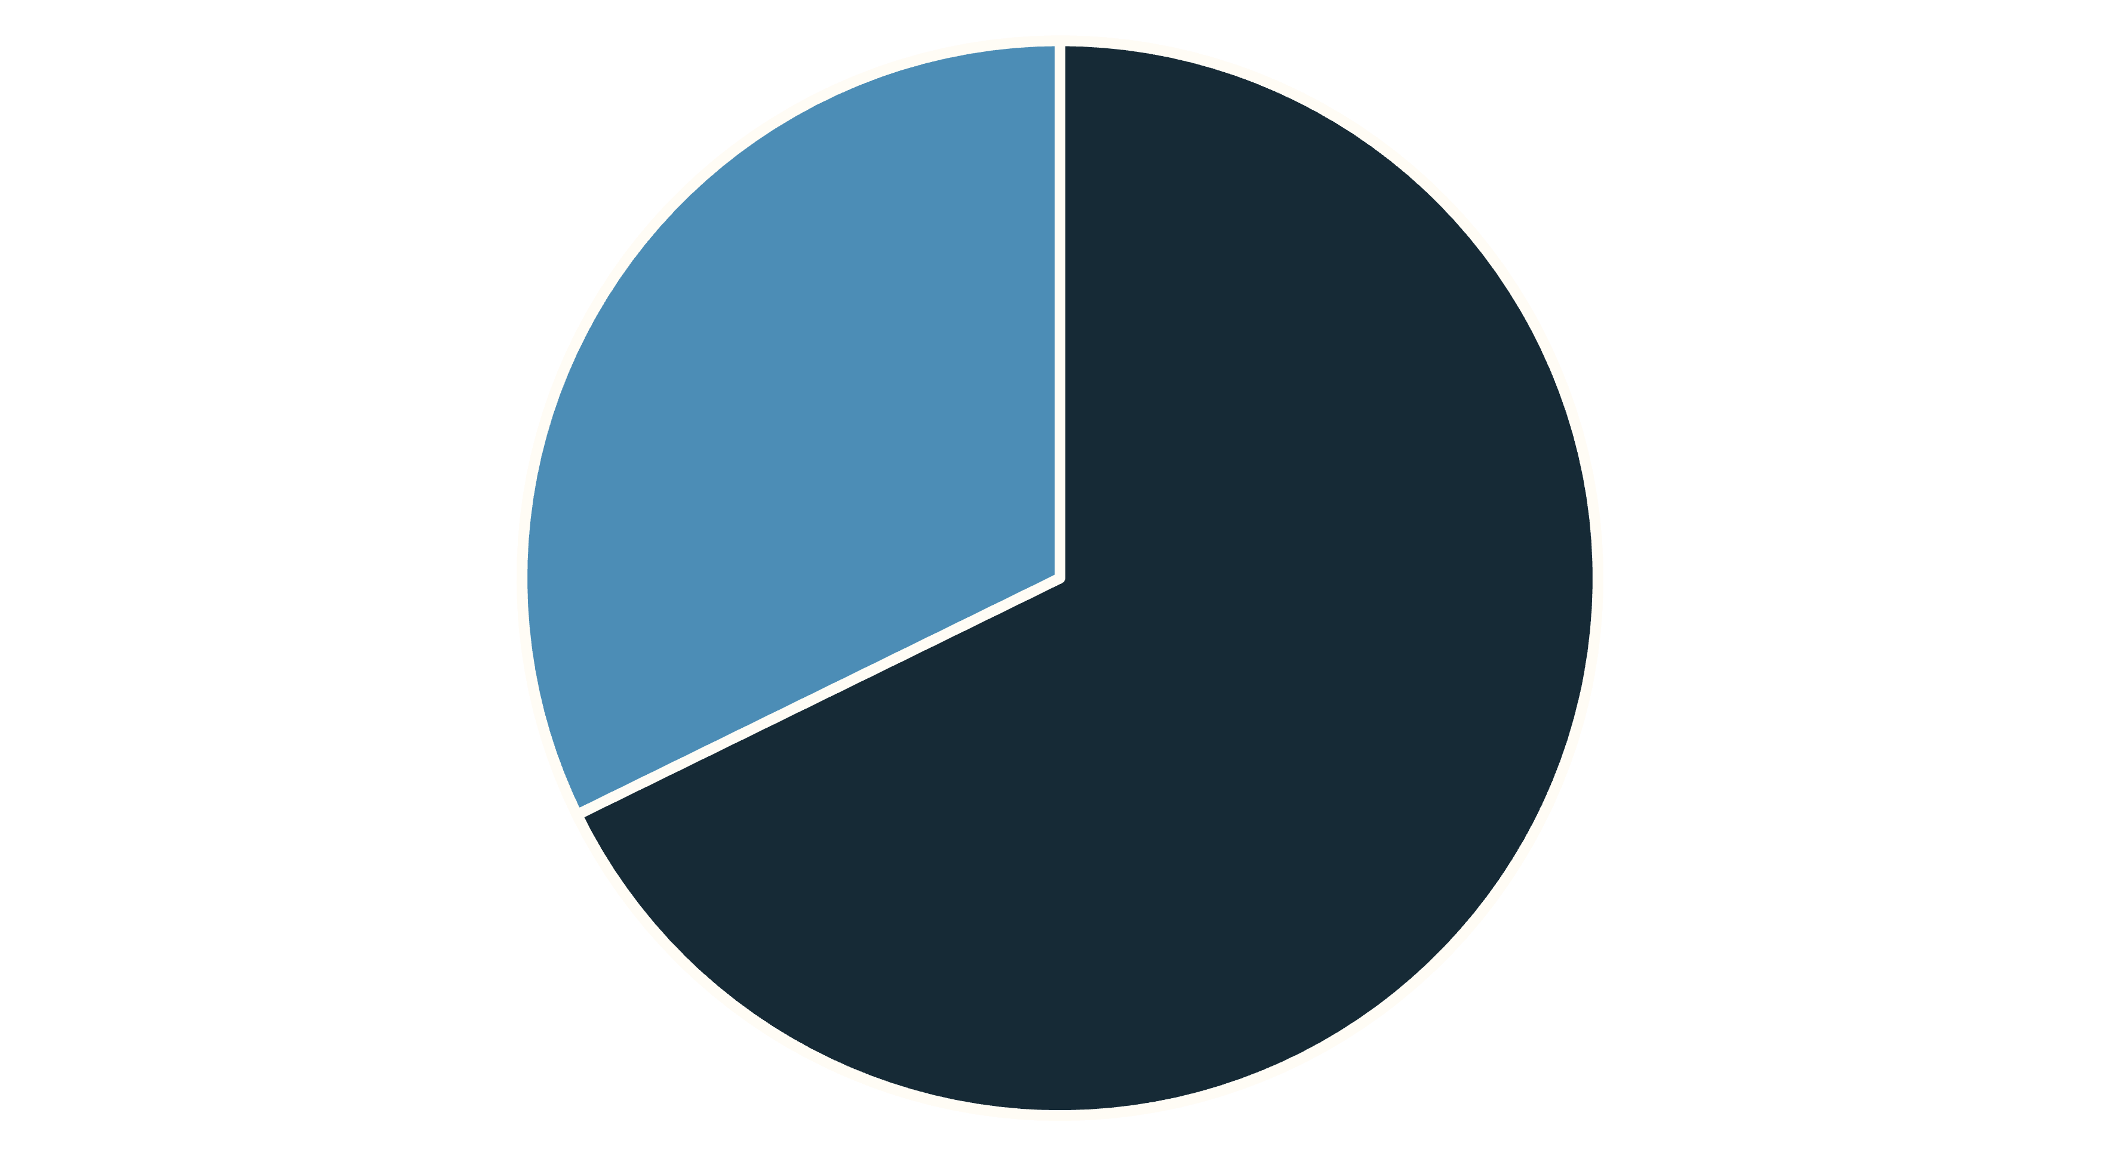
Gender-Wise Revenue Share
Male customers contribute significantly more to revenue,
highlighting a potential area for targeted marketing towards
female demographics.
Male
Female

Slide 6
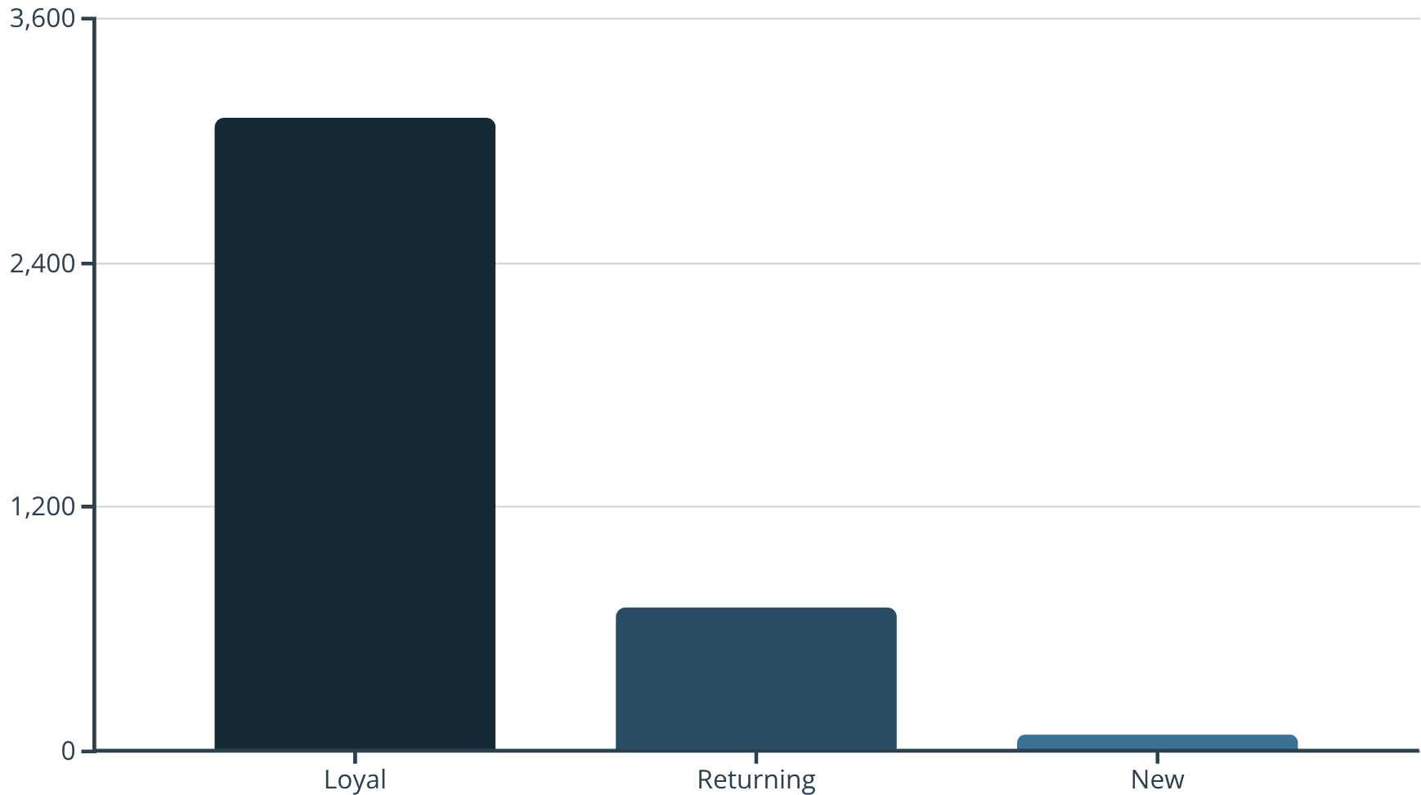

Customer Segmentation & Top-Rated Products
Customer Segments
Top-Rated Products
Gloves: 3.85
Sandals: 3.84
Boots: 3.82
Loyal customers form the largest segment, highlighting the importance of retention strategies.

Slide 7
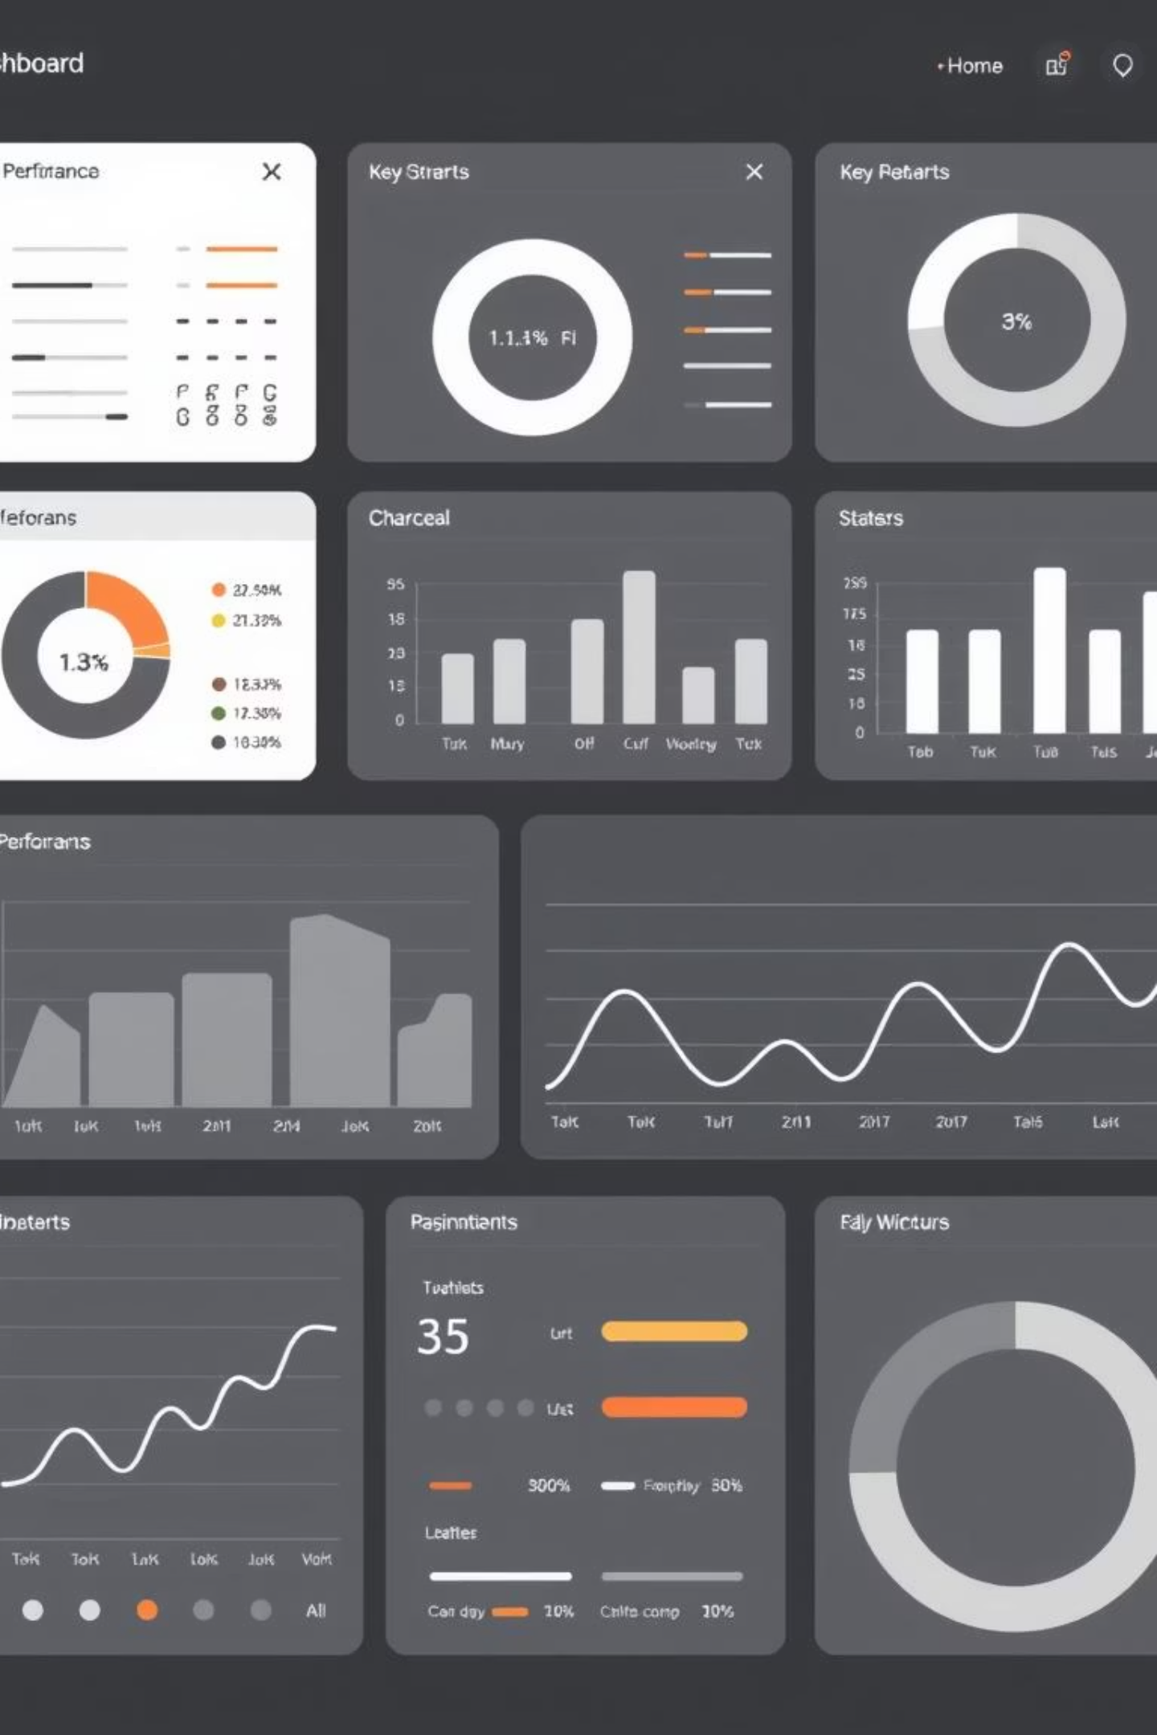
Key Performance Indicators
3,900
$59.8
3.8
Customers
Avg Purchase
Avg Review
Reflects the total transaction volume analyzed.
Insight into typical customer spending behavior.
Highlights general customer satisfaction across products.

Slide 8
Shipping Preferences Impact
Express Shipping
Standard Shipping
$60.5
$58.5
Average purchase amount
Average purchase amount
Express shipping customers spend 12% more per transaction

Slide 9





Strategic Recommendations
Targeted Campaigns
Subscription Growth
Focus marketing on female demographics to balance revenue share.
Develop strategies to convert non-subscribed customers.
Product Optimization
Age Group Engagement
Leverage top-rated products like gloves and sandals.
Maintain focus on Young Adults while exploring engagement with Seniors.

